Slide 1

MASS MEDIA

Slide 2

What are the Mass Media?
They are forms of communication designed to reach many people. These are the newspapers, radio and television stations, websites, etc., through which information is communicated to the public.

Slide 3

Mass Media are a very important part of our everyday life

Slide 4
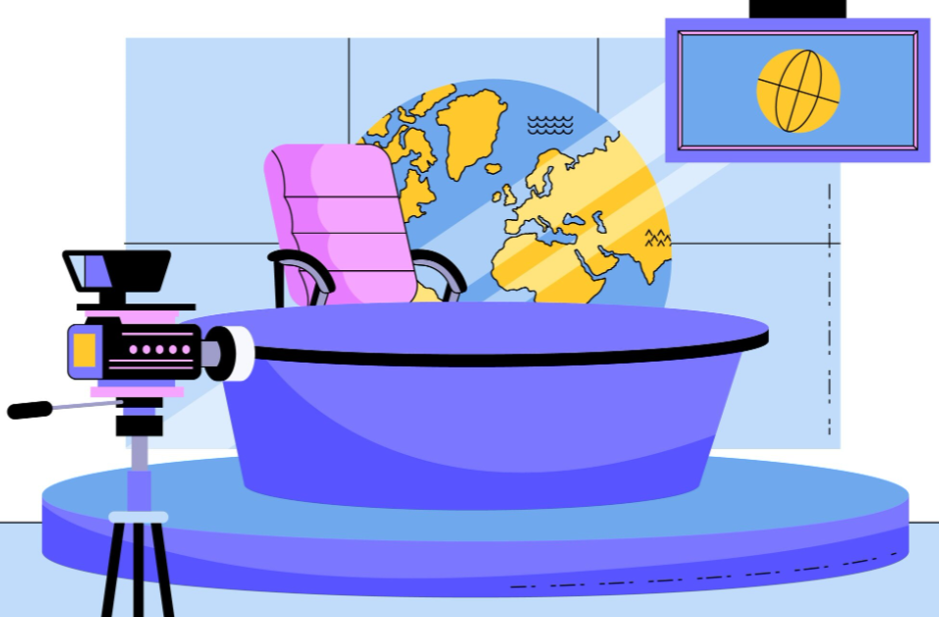
They inform people about different events .
In addition, they entertain people or even help to make their lives easier and better.

Slide 5

A lot of newspapers have advice columns, review of books, comics, news, crossword puzzles, etc. Most of them have different pictures, photographs and illustrations. Mass media also focus public attention on the most urgent problems of the society..

Slide 6

But the most important thing that newspapers, radio and TV give information to people.

Slide 7

What way do the Mass Media help people?

Slide 8


The Media help people
To receive information
To act as a guardian of society
To travel around the world without wasting money
To relax
To keep in touch with each other
To get information

Slide 9
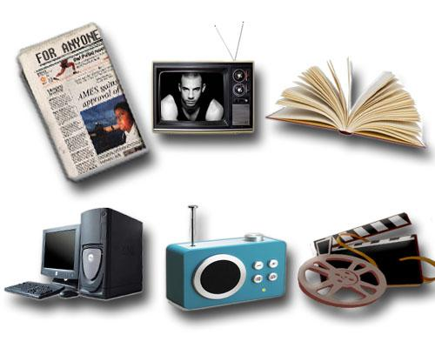
The role of the Media in our life
educate
provide
manipulate
influence
connect
warn
act
inform
entertain
focus

Slide 10
Mass Media
Printed media | Outdoor media | Electronic media
-newspapers | -advertisements | -radio
-magazines | -billboards | -television
-photo | -brochures | -Internet

Slide 11
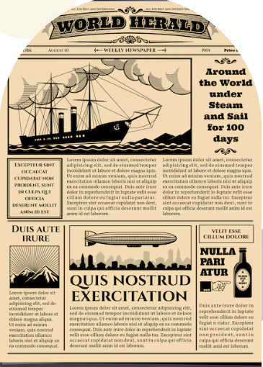
THE END

